Slide 1

OS Lab 7

Slide 2
Introduction to Posix threads
What is a thread?
A sequence of machine instructions.
The smallest unit of processing that a scheduler works on.
Threads and processes -
A process (created by a fork() command) can have multiple threads of execution which are executed asynchronously.
Every process has at least one thread

Slide 3
What is a Thread?
A thread is a semi-process, that has its own stack, and executes a given piece of code.
Threads are also called lightweight processes since a thread is "lighter weight" than a process.
That is, thread creation can be 10–100 times faster than process creation
Unlike a real process, the thread normally shares its memory with other threads (whereas for processes we usually have a different memory area for each one of them)
A Thread Group is a set of all the threads executing inside the same process.
They all share the same memory, and thus can access the same global variables, same heap memory, same set of file descriptors, etc.
All these threads execute in parallel.

Slide 4
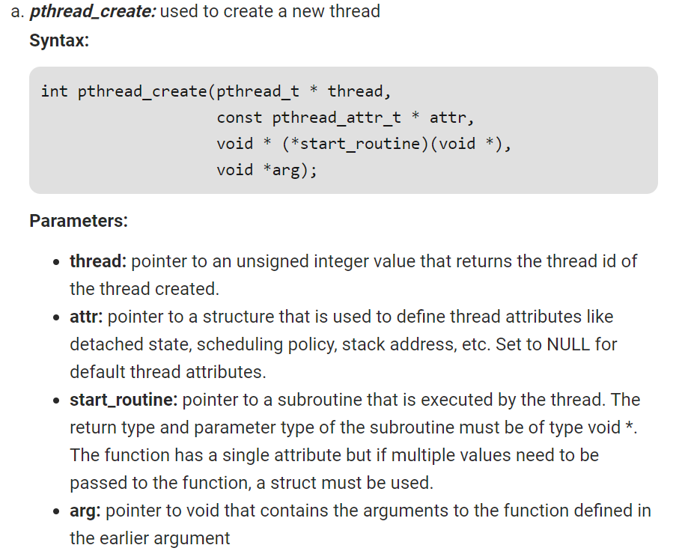

Slide 5
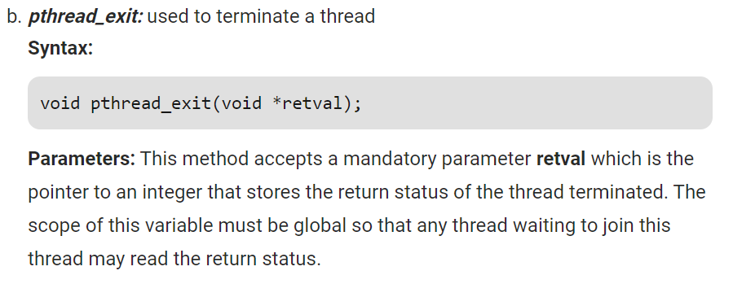

Slide 6
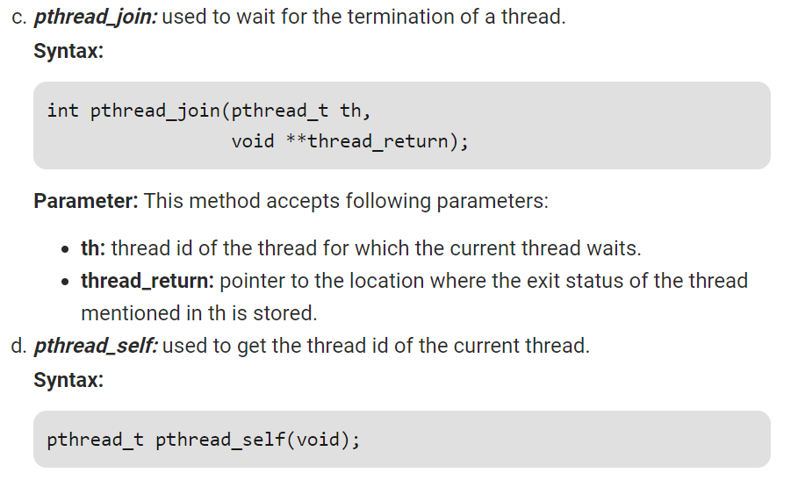

Slide 7
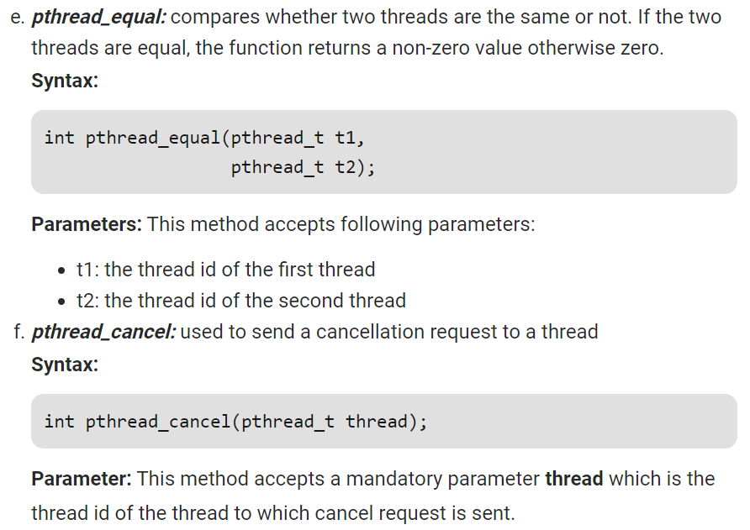

Slide 8
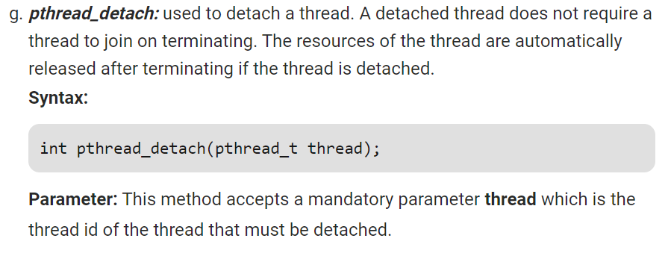

Slide 9
Required Library And How To Compile And Execute File In Linux.
#include<pthread.h>
For C language>>> gcc filename.c –lpthread
For C++ language>>> g++ filename.cpp –lpthread
Execute it with>> ./a.out

Slide 10
EXAMPLE

Slide 11
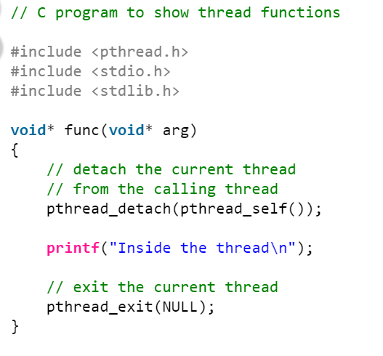
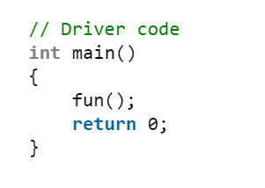
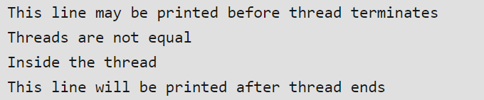
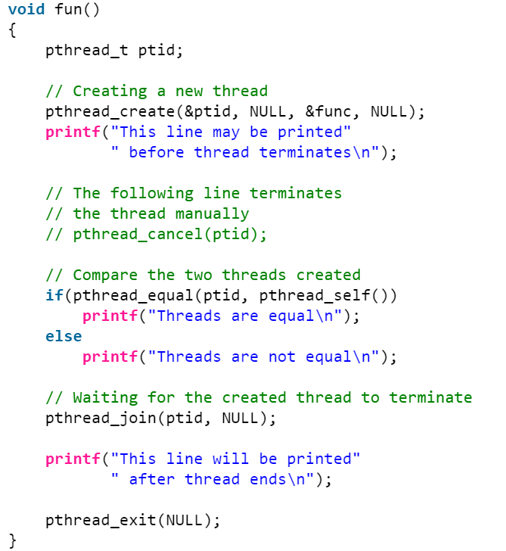

Slide 12
#include <stdlib.h>
#include <stdio.h>
#include <pthread.h>
#include <unistd.h>
void* routine() {
printf("Hello from threads\n");
sleep(3);
printf("Ending thread\n");
}
int main(int argc, char* argv[]) {
pthread_t p1, p2;
if (pthread_create(&p1, NULL, &routine, NULL) != 0) {
return 1;
}
if (pthread_create(&p2, NULL, &routine, NULL) != 0) {
return 2;
}
if (pthread_join(p1, NULL) != 0) {
return 3;
}
if (pthread_join(p2, NULL) != 0) {
return 4;
}
return 0;
}

